Slide 1
Government Customer Segmentation
Sleepers Research
10/16/2020
Autumn Li

Slide 2
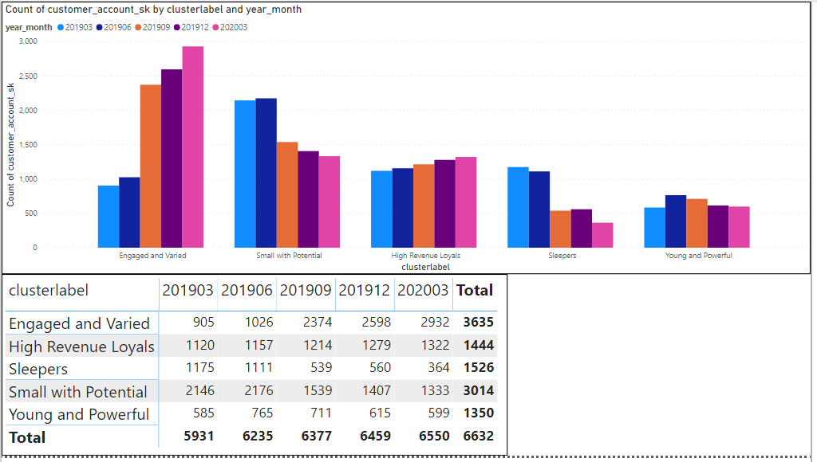
Background Information
There was a price change for government vertical at 2019 Q2

Slide 3
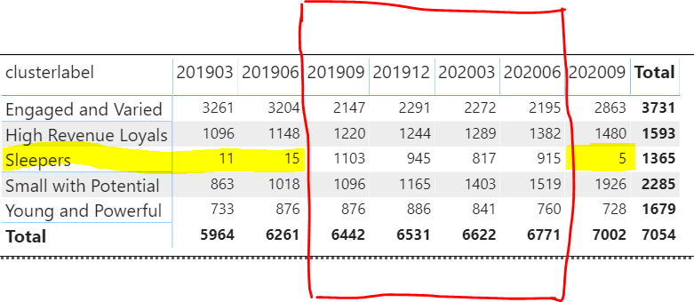
Model Recalibrating
Due price change, we had to recalibrate the segmentation models
Segmentation models works fine since 2019 Q3-2020 Q2

Slide 4
Why only 5 sleepers in Q3 2020?
Price change again?
Key attributes behave abnormally
Sleepers characteristics may change

Slide 5
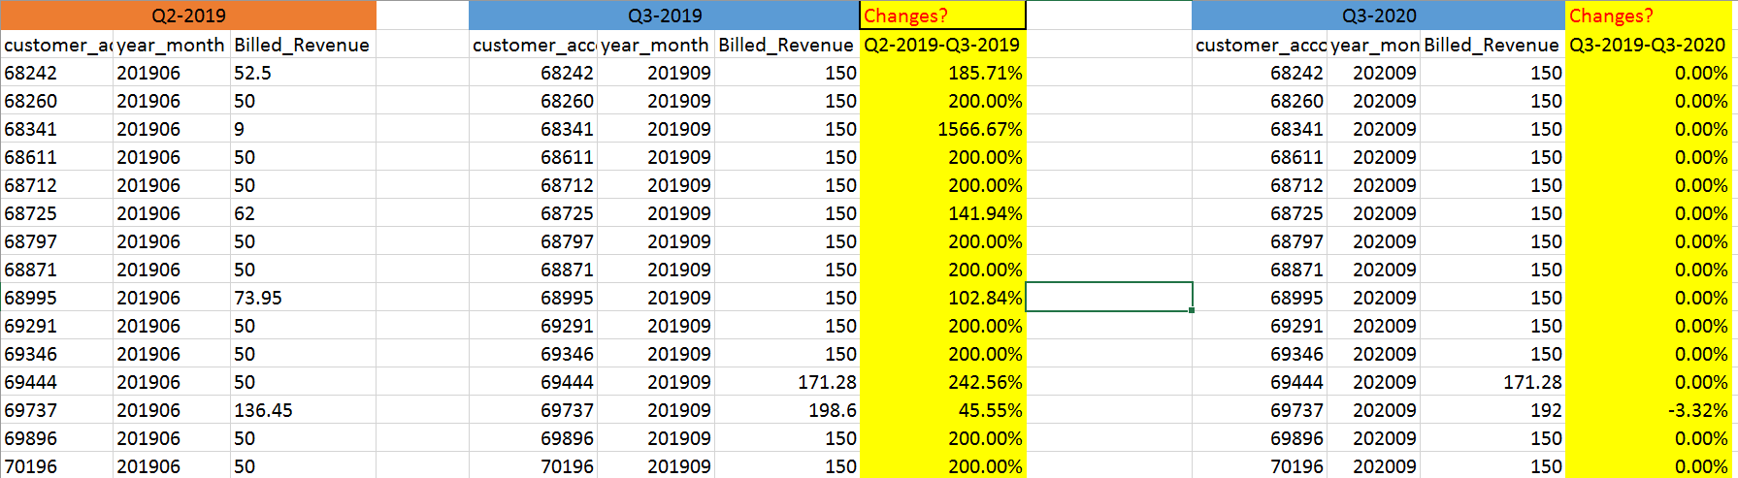
1. Population shift is Not due to price change
There are only 114 accounts have price change > 50% between Q3 2019- Q3-2020, price change is not a reason

Slide 6
2. Key Attribute behave abnormally
Among 56 attributes, which are key attributes relate to the sleepers assignment?
Method:
Backward: drop attribute one by one, with replacement
Forward: add attribute one by one, without replacement

Slide 7
2. Key Attribute behave abnormally
Key attributes are :
How sleepers react to these two attribute?
yoy_pct_3mos_growth, yoy_pct_growth
year_month | cluster_label | yoy_pct_3mos_growth_mean | yoy_pct_growth_mean
201903 | Sleepers | 0.055897273 | 0.146258182
201906 | Sleepers | 0.040406 | 0.114312667
201909 | Sleepers | 0.991635476 | 0.414575159
201912 | Sleepers | 0.810583884 | 0.756191323
202003 | Sleepers | 1.004771126 | 1.229949621
202006 | Sleepers | 0.695948219 | 1.499872361
202009 | Sleepers | 0.03 | 0.12216

Slide 8
Sleepers Characteristics
Sleepers pool: From 201909-202003, there are 1359 unique customer_account_sk assigned as “sleepers”
1010 accounts from 1,359 sleepers pool had price change in 2019 Q2
You can find 900+ sleepers always move in the 1,359 sleepers’ pool
900 + sleepers move to Engaged and Varied sections in 201903/201906 before price change
900+ sleepers move again in 202009. This is the a year after price change, all the accounts completely get rid of the effect of the price change

Slide 9
Part 2
How can we make sleepers more stable?

Slide 10
Model recalibrating should improve
1. Should not impact other clusters
2. Keep sleepers stay where they come from

Slide 11
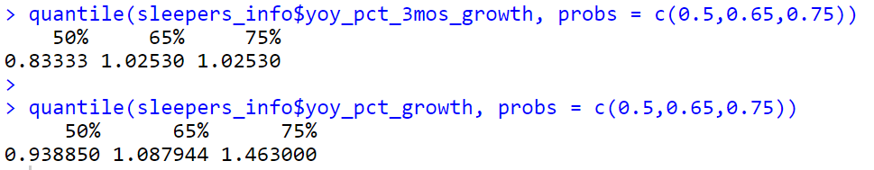
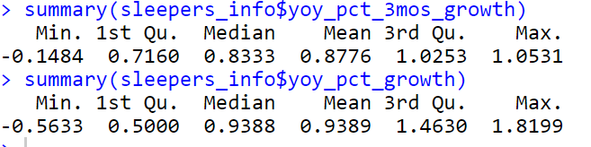
Method
Only adjust Key attribute(yoy_pct_3mos_growth, yoy_pct_growth) for sleepers accounts
Two line of code:
yoy_pct_3mos_growth = ifelse(is.element(customer_account_sk, all_sleepers$customer_account_sk),1.02,yoy_pct_3mos_growth)
yoy_pct_growth = ifelse(is.element(customer_account_sk, all_sleepers$customer_account_sk), 1.08,yoy_pct_growth)

Slide 12
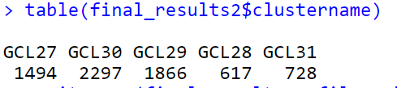
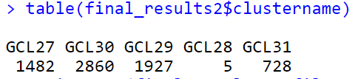
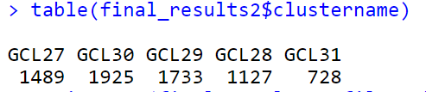
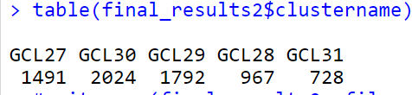
Why 65% percentile
This is the 202009 results on 50% percentile
This is the 202009 results without adjustment
This is the 202009 results on 75% percentile
This is the 202009 results with 65% percentile

Slide 13

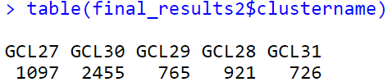
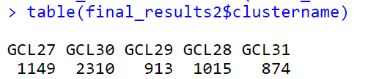
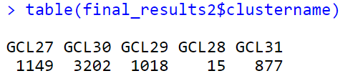
Treatment Application
For data of 201903
For data of 201903
Before
After
For data of 201906
For data of 201906
Before
After

Slide 14
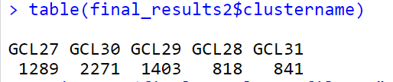
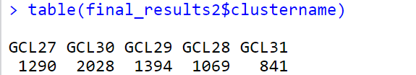
How do we know the treatment works?
Newly assigned sleepers are still belong to 1,359 sleepers pool
For other normal segmentations, such as 202003, changes are mostly between engaged& varied, and sleepers
Before treatment
After treatment

